Slide 1
Manual Testing Doc
Toy Robot Project

Slide 2
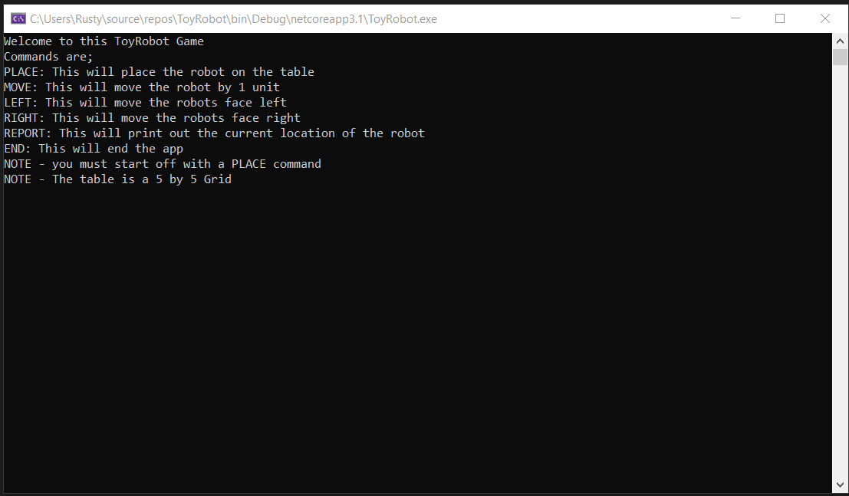
App start
When you start the app it shows instructions on how to use the app along with the commands

Slide 3
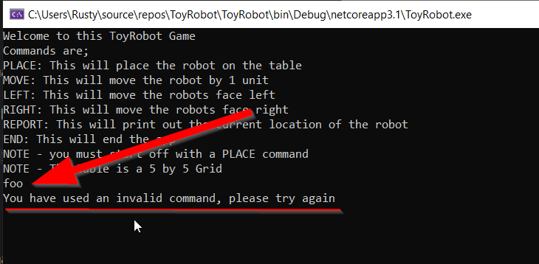
If you put in a not known command the app will let the user know

Slide 4
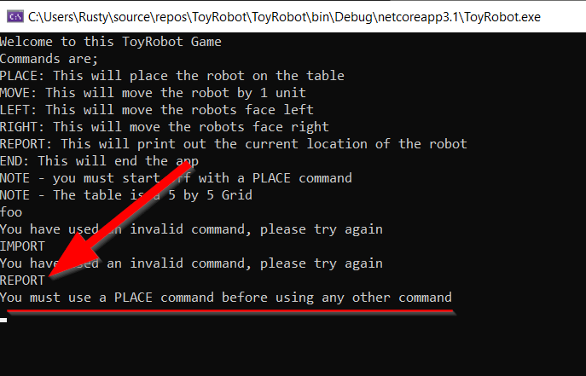
If you add a valid command but have not used a place command then the app will let the user know this

Slide 5
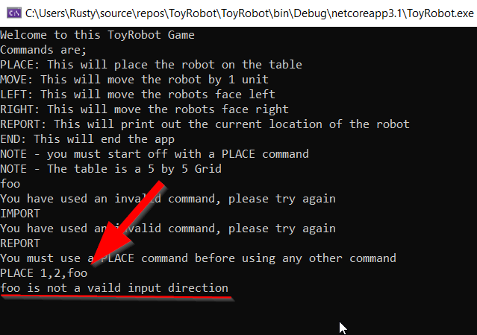
Adding a place command that does not have a valid direction the app will let the user know

Slide 6
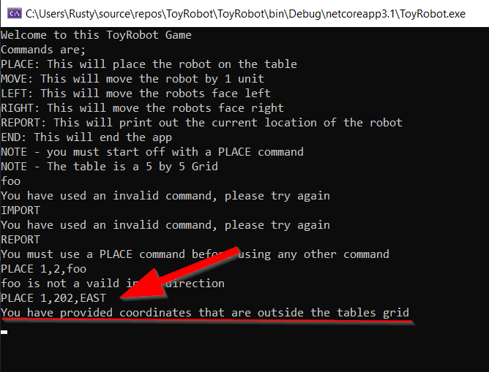
Adding a place command but the coordinates are larger than the tables grid will also result in output explaining to the user of this issue

Slide 7
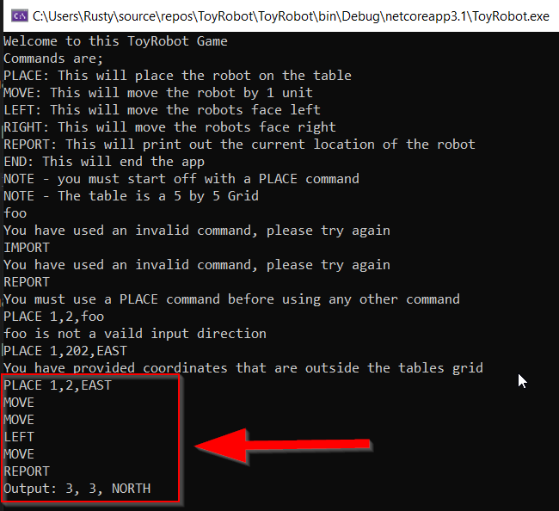
Adding the example commands provided for the test will result in the same output

